Slide 1

Repetition Structure I
while loop and flow control
Notes:
Is life getting you down? Does it sometimes feel like you’re just doing the same things over and over again? Good news, everyone, computers can help! One thing that computers can do better than humans is tedious repetitive tasks because unlike people, computers don’t get bored or careless. So as long as we give them clear careful instructions, computers can do repetitive stuff really well and never complain.
Today, we will introduce repetition structures (or loops), which is how you can get Python programs to execute the same statements over and over again. With this, you can write one line of code and get Python to run it a thousand times. Or a hundred thousand, or a million. Isn’t that just awesome?

Slide 2
Objectives
At the end of this lesson, you will be able to….
apply the use of repetition structure in the creation of programs
code using while loop
alter the program flow of loops with break and continue statements
Notes:
So in this lesson, you will learn how repetition structures work, and therefore figure out how to use them in your programs. Specifically, we will introduce one type of Python repetition structure called the while loop that will keep running while a condition is True. Finally, we will also cover break and continue statements that can let you either end your loop early or skip to the next iteration, so that your loops can do even more neat stuff.

Slide 3
Repetition Structure
Notes:
So let’s start with repetition structures in general. Remember the 3 main ways that programs can flow? There was sequential execution, which is just running the statements in order, and selection, which is if, if-else and if-elif-else. The third way programs can flow is using repetition structures.

Slide 4
What is a Repetition Structure?
Execute a block of program statements repeatedly
Examples of repetitive activities:
Repeated prompting of password after incorrect entry
Alexa listening for wake-up command
Windows detecting mouse clicks
2 types of repetition structure
while loop and for loop
Notes:
Repetition structures allow programs to execute the same block of code multiple times, and this will keep happening until some condition is detected that tells the program to stop.
Whenever there is a repetitive activity involved in a program, a loop is involved. That program asking you for your password after you mistyped that 12-character nonsensical string of characters with upper and lowercase letters and at least one number? That’s a loop. Alexa listening for you to wake it up to play the latest Taylor Swift single? That’s a loop. In fact, your OS is running a loop right now, because it is constantly checking whether you have clicked a mouse or hit a key so that it can react appropriately.
Python provides two types of repetition structures: the while loop and the for loop. In this lesson, we will cover the while loop, and we will look at the for loop in our next lesson.

Slide 5
while Loop
Checks the condition
if the condition is true, executes the block of statements in the loop
Repeat from step 1 until condition is false
False
condition
True
block of statements
while condition:
statement
statement
Notes:
So what’s a while loop? In English, it implements the logic of “while a condition is true, keep doing something.” For example, while I am hungry, keep looking for something to eat.
The general flow of a while loop is given in this flow chart. We start by checking a condition. If it is true, we execute a block of statements, also known as the loop body; a single execution of the loop body is called an iteration. We then loop back to the condition and check it again, and if it is still True, we will again execute the block of statements. This continues until the condition is detected to be False, whereupon we exit the loop and continue with the rest of the program.
In Python, the while loop is implemented using this format, which is very similar to the if structure. You have the keyword “while” followed by a condition and a colon. You then put all the statements that you want to execute while the condition is True indented beneath this line.

Slide 6
while Loop
Typical condition statement includes
Controlling the number of iterations the loop will execute
Terminating the loop with a special variable known as a sentinel or flag
while condition:
statement
statement
False
condition
True
block of statements
Notes:
Clearly, unless something happens within the block of statements to change the truth value of the condition, this will just loop forever. A loop that never ends is called an infinite loop, which is usually a bad idea because, frankly, you have other things to do besides waiting for a program that never ends. Typically though, we will write the condition in such a way that the loop will eventually end.
For example, you might maintain a variable that counts the number of iterations starting from zero, and specify in the condition that the number of iterations is less than 10. Then in the loop body, you always add 1 to this variable. Therefore, after 10 iterations, the number of iterations will no longer be less than 10, so then the loop exits.
Another common way to terminate a loop is to have a special variable known as a sentinel or flag. This variable is commonly a Boolean variable that is included as part of the condition of the loop. Within the loop body, something will happen that eventually changes the value of this variable, causing the condition to be False and the loop exit.
Let’s take a look a couple of examples.

Slide 7
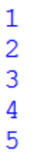
Example: Control Number of Iterations
Print numbers 1 to 5
Pseudocode:
Python code:
SET count to 1
WHILE count less than or equal to 5 THEN
display count
increment count
ENDWHILE
count = 1
while count <= 5:
print(count)
count = count + 1
Notes:
Here is an example of a while loop where we control the number of iterations. Suppose we want to write a program that prints the numbers 1 to 5 like this. Our pseudocode for the program may look like this.
In our algorithm, we first set a variable called count to 1. Next, we write our while loop, specifying in our condition that we want to keep looping as long as count is less than or equal to 5. Within the loop body, we print the value of count, then add 1 to count. So in the first iteration, count is 1. The while condition checks that count is indeed less than or equal to 5, so the program prints 1, then increments count to 2. The while loop returns to the condition, verifies that count is still less than or equal to 5, and so it prints 2 and sets count to 3, and so on. Eventually, the program will print 5 and set count to 6, whereupon the while condition will evaluate to false and the loop will end.
And here is the corresponding Python code. Not too difficult once you figure out the logic, right?

Slide 8
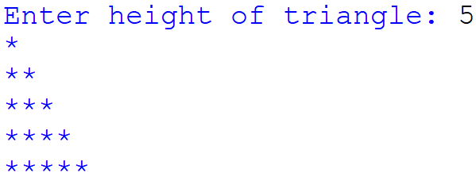
Example: Print a Triangle
Given the height, print a right-angled triangle made of stars
Sample output:
Notes:
Let’s write a simple program to print a right-angled triangle made of stars. The user will enter the height, and then the program will print the triangle with the given height. Here is an example where the user enters a height of 5.
How would we write this program? We know that we will always start with one star, then two, then three, and so on until we reach the height. So we should have some variable that starts at 1 to tell us to print one star, and in each iteration we will add one to this variable. In the next iteration, the variable will contain 2, so we will print 2 stars, and we will add 1 to this variable again. We will keep doing this until we have reached the height of the triangle.

Slide 9
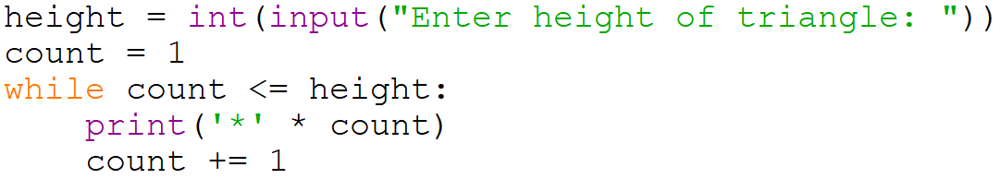
Example: Print a Triangle
Given the height, print a right-angled triangle made of stars
Pseudocode:
Python code:
Read height
SET count to 1
WHILE count less than or equal to height
display count number of '*'
increment count
ENDWHILE
Notes:
And this is the pseudocode for our algorithm. We first ask the user for the height, and then set a variable called “count” to 1. We know that if the height is, for example, 5, we want to stop the program after printing 5 stars. So our while condition would check, ”while count is less than or equal to 5, keep printing”. Which means that once count is greater than 5, we exit the loop. Inside the while loop body, we will print a number of stars equal to count, and then increment count by one.
Having figured out our pseudocode, writing this out in Python, like this, is relatively straightforward. The important thing is making sure that the condition is correct – you want to keep looping while count is less than or equal to height. If you wrote “while count less than height” instead, you will stop the program one line too early.

Slide 10
Activity Break!
Lecture activities are in a separate file (Word document)
You are required to submit your solution for the activities in POLITEMall when you have completed all of them
Try to work on activity 1 now…
Notes:
Music from https://www.fiftysounds.com/royalty-free-music/marseille.html

Slide 11
Terminate with Sentinel
A sentinel (also known as a flag) is a special variable used as a condition of termination, typically in a loop
When the sentinel has a specific value (or set of values), the loop terminates after the current iteration
Typical use of sentinel:
Initialize sentinel to non-termination value
WHILE not (sentinel has termination value)
…
ENDWHILE
Notes:
For our next example, we will see how we can use a sentinel or flag variable to terminate a loop. This is just a variable that is used as the loop condition, and when the sentinel value is set to some specific value, the loop will terminate.
Here is a typical use of a sentinel variable. You first initialize the sentinel to be some value that is not a termination value. The while loop is then written as “while the sentinel variable does not contain a termination value, execute your loop body”. Somewhere in your loop body, there will be some code that sets the sentinel to a termination value. At the end of that iteration, the while condition will be evaluated and found to be False, and so the loop will terminate.

Slide 12
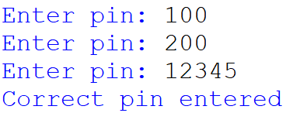
Example: Terminate with Sentinel
Prompt the user for pin until correct pin has been entered
pin = 0
while pin != '12345':
pin = input('Enter pin: ')
print('Correct pin entered')
Notes:
Here is a simple example, where the program asks the user for their pin. As long as the correct pin 12345 is not entered, this program will keep looping. Only after the user enters the correct pin will the loop terminate.
Yes, I insist on saying pin, because I’m one of those “ngiaow” people who gets triggered when someone says that they are entering their pin number into their ATM machine. So you better double confirm. Don’t make me repeat again one more time.

Slide 13
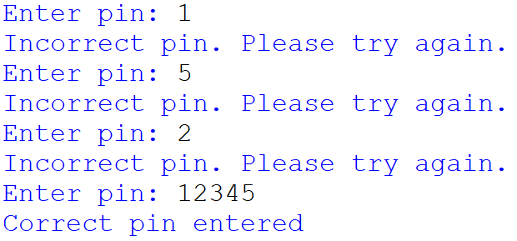
Example: Terminate with Sentinel
Prompt the user for pin until correct pin has been entered
correct_pin = '12345'
correct_entry = False
while not(correct_entry):
pin = input('Enter pin: ')
if pin == correct_pin:
print('Correct pin entered')
correct_entry = True
else:
print('Incorrect pin. Please try again. ')
Notes:
The previous example is a little clumsy, because you have to put the correct pin as part of the condition. In practice, we often use a Boolean variable as a sentinel. Take a look at this improved version of our pin entry program. We place the correct pin into a separate variable called correctPin. We then declare a Boolean variable called correctEntry, which is set to False at the start because the user has not yet entered the correct pin. We write our while loop as “while not correctEntry”, which means that the loop will keep running as long as correctEntry is False (since that would mean that not correctEntry is True). In the loop body, we check if the correct pin has been entered. If it has, we set correctEntry to True, otherwise we print a message indicating the pin was incorrect.
Here is a sample output from this program. It will keep looping until the correct pin is entered.

Slide 14
Activity Break!
Lecture activities are in a separate file (Word document)
You are required to submit your solution for the activities in POLITEMall when you have completed all of them
Try to work on activities 2 to 4 now…
Notes:
Music from https://www.fiftysounds.com/royalty-free-music/marseille.html

Slide 15
Infinite Loop
A loop that will not terminate is called an infinite loop.
Infinite loop occurs as its condition always evaluates to True
Execution of the program can only be stopped by “killing” the program.
So it is important to make sure the condition of the loop will eventually become false so that the loop will terminate.
Notes:
At this point, we should be aware of the possibility that we might accidentally write a loop that will never end. Such a loop is called an infinite loop, and is caused when its condition always evaluates to True.
Unintended infinite loops are bad because they will run forever. You go to sleep? Still running. Wake up the next day? Still running. You start playing Call of Duty? It’s still running in the background taking up resources and causing you to get lag-killed. It’s a nightmare.
The only thing you can do to stop a program with an infinite loop is to kill it with extreme prejudice. Therefore, it is super important to make sure that the condition of a loop will eventually become false so that the loop will terminate.

Slide 16

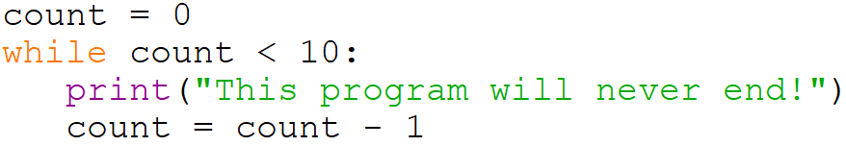
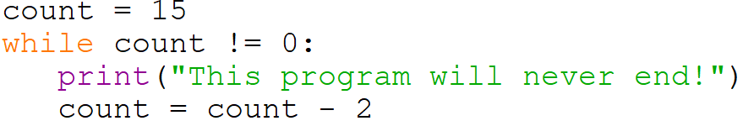
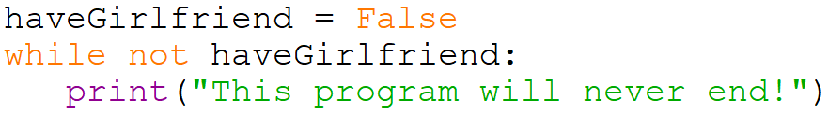
Infinite Loop - Examples
Notes:
Let’s take a look at some examples of infinite loops. The most straightforward is when there is a loop that starts with “while True:”. In this case the condition is just the value True, and True will always be True, so this program will never end.
That’s a bit of a weird example, so here’s a slightly more realistic one. You may start with a sentinel variable called count that starts at zero, and you want the loop to keep running as long as count is less than 10. However, instead of incrementing count, you accidentally decrement it, so count keeps going down and “count <10” will always be True, so this will never end.
Here’s another example. This loop keeps running as long as count is not zero. You start with count = 15, and each iteration you set count to be equals to count – 2. The problem is that count will go from 15 to 13, 11, and so on down to 3, 1, then -1, -3 and so on. It never hits zero, so this loop will never end.
Or you might have a program that keeps running as long as you do not have a girlfriend. And since you will never have a girlfriend, this program will never end. I’m kidding! I’m kidding. Let’s move on.

Slide 17
Activity Break!
Lecture activities are in a separate file (Word document)
You are required to submit your solution for the activities in POLITEMall when you have completed all of them
Try to work on activity 5 now…
Notes:
Music from https://www.fiftysounds.com/royalty-free-music/marseille.html

Slide 18
Control Flow
break
continue
Notes:
So far, we have talked about the standard way that a loop executes, which is that it will keep running as long as the condition is True. Specifically, once it starts its loop body, it will finish the entire loop body before it checks the condition. Sometimes, we don’t want that. Sometimes we want the loop body to stop executing as soon as some termination condition is detected. Or we might just want the loop to skip the rest of the current iteration to go to the next. That’s what these two special statements “break” and “continue” allow you to do. So let’s talk about these two nifty little control flow statements.

Slide 19
break Statement
A break statement can be used to exit from a loop
When a break statement is executed within a loop,
the loop is terminated
program control is passed to the first statement after the loop.
A break statement is often written in an if block when it is used in a loop
Notes:
A break statement can be used to exit from a loop. It is just a single word “break” on its own line. When Python encounters the break statement while executing a loop body, it immediately terminates (or breaks out from) the loop, and continues execution at the first statement after the loop.
break is often used in loops where there is a main condition that controls the loop, but there may be some special case that happens infrequently that should also end the loop. Rather than making the loop condition complicated by handling each of these special cases in one super messy compound condition, it may be neater to handle these special cases as they occur in the loop body. This is why break statements are often written in an if block within loops, because the if block checks if the special case has happened.

Slide 20
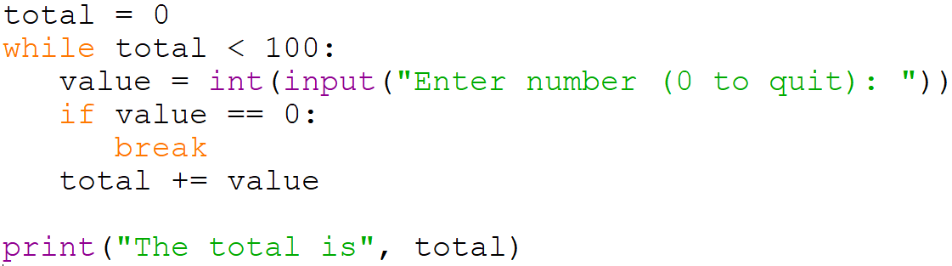
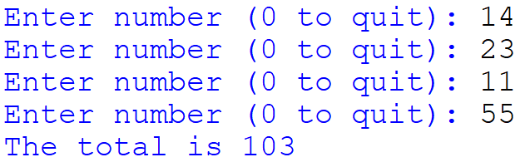
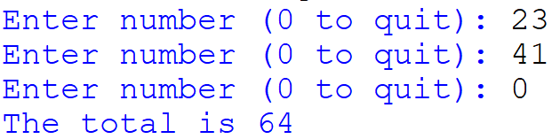
break Statement – Example 1
Notes:
Let’s take a look at a couple of examples. In this program, we ask the user to enter numbers, and we will keep adding them up until the value is greater than or equal to 100, whereupon we will print out the total. However, the user can stop the program early by entering a zero. When this happens, we use break to exit the loop. These sample outputs show both cases. For such a program, using break is convenient because we have a usual while condition, which is when the total is still less than 100, and a less frequent alternative condition, which is when the user enters zero.

Slide 21
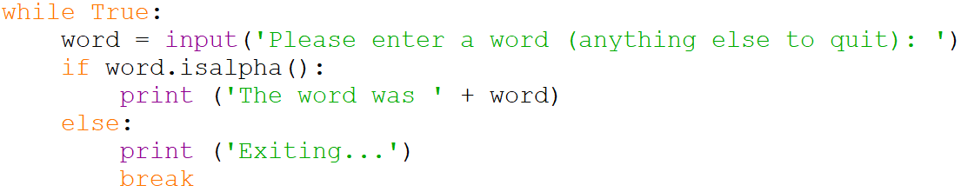
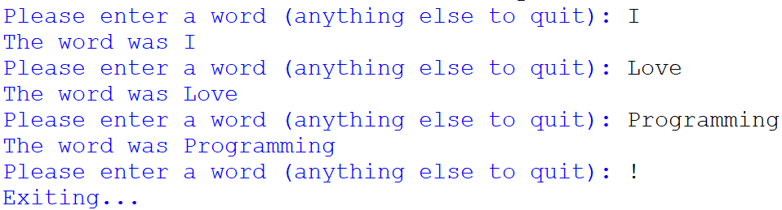
break Statement – Example 2
Notes:
Here’s another example. Remember we did that stupid “while True” example earlier? Why would anyone do something so stupid? It turns out that since we have the break statement, using “while True” can be a completely valid way of creating an infinite loop on purpose. In this example, we intend to keep running this loop forever as long as the user keeps entering words, but once they enter something that isn’t a word, we use break to end the loop.
In summary, break is useful when there is some condition you want to detect that should cause the loop to end immediately, without running the rest of the loop body. It’s pretty useful that way.

Slide 22
continue Statement
A continue statement can be used to skip to the next iteration of the loop
When a continue statement is executed within a loop,
the current iteration is terminated. Rest of code in current iterature is skipped.
program control continues to check the while condition.
A continue statement is often written in an if block when it is used in a loop
Notes:
Finally, we have the continue statement, which is used to skip to the next iteration of the loop. Just like break, a continue statement is just the word continue on its own line. When Python hits a continue statement while processing a loop body, it will skip the remaining lines of the loop body and go back to check the condition on top.
Just like for the break statement, continue is usually used for special cases where if it happens, the rest of the loop body should be skipped, but the loop should continue to the next iteration. Let’s see an example.

Slide 23
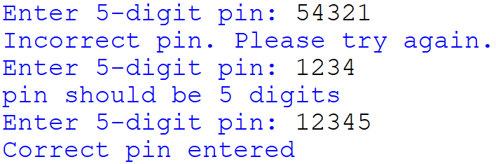
Example: Terminate with Sentinel
Prompt the user for pin until correct pin has been entered
correctPin = '12345'
correctEntry = False
while not(correctEntry):
pin = input('Enter 5-digit pin: ')
if (len(pin) != 5):
print('pin should be 5 digits')
continue
if pin == correctPin:
print('Correct pin entered')
correctEntry = True
else:
print('Incorrect pin. Please try again. ')
Notes:
Remember our example of the program that asks for the correct pin? Suppose pins are always 5 digits, and we want to handle the special case of the user entering a pin that is not 5 digits. In this version of the program, we first detect if the pin is 5 digits long. If not, we print a helpful information message and skip the rest of the loop body using continue. Otherwise, we run the rest of our program.
In summary, continue should be used if there are some special cases that tell you “don’t bother processing this iteration, but you should continue with the remaining iterations”. In that case, just tell the loop to “continue” with the next iteration.

Slide 24
Activity Break!
Lecture activities are in a separate file (Word document)
You are required to submit your solution for the activities in POLITEMall when you have completed all of them
Try to work on activities 6 and 7 now…
Notes:
Music from https://www.fiftysounds.com/royalty-free-music/marseille.html

Slide 25
Summary
Repetition structure allows statements to be repeated as long as a condition is True
The while loop checks the condition first to decide whether to enter the loop
The break statement breaks out of the loop completely.
The continue statement skips the remaining part of the current iteration and continues to the next iteration.
Notes:
And that’s our introduction to repetition structure or loops, specifically while loops. We know that loops will repeatedly execute a set of statements as long as a condition is True, and the while loop is one such repetition structure. The while loop will check the condition first, and if it is True, it will proceed to execute the entire loop body. At the end of this execution, it will go back to the top to check the condition again.
If you want the loop to act differently, there are two statements provided that help you do that. The break statement will break out of the loop completely, and the continue statement will skip the rest of the current iteration to go back to check the condition. Both statements are usually used for special cases, but as you become better programmers, there may be other clever ways of using them in your loops.

Slide 26
Reading Reference
Python 3 Documentation
https://docs.python.org/3/reference/compound_stmts.html#while
Learn Python Tutorial
https://www.learnpython.org/en/Loops
Notes:
Here are a couple of reading references for you if you want to find out more about loops in general, and the while loop in particular. Or you can go back to rewatch these slides, as in, you know, loop back to the start. Urgh, even I hate that joke. Right, see you next time.

